Slide 1



WEB SCRAPING AND EXPLORATORY DATA ON
IMDB MOVIES

Slide 2

TEAM MEMBERS:
D. L. NarasimhaRao Qualification : Master of Computer Application
D. Pavan Kumar Qualification : Bachelor of Technology (Mech)

Slide 3


Contents
Selection of website
Problem Statement
Libraries used
Data frame Creation
Data Cleaning
Descriptive Statistics
Univariant Analysis
Bivariant / Multi-variant analysis
Final Conclusion

Slide 4
WEBSITE:
https://www.imdb.com/list/ls098063263/?sort=list_order,asc&st_dt=&mode=detail&page

Slide 5
PROBLEM STATEMENT
Examination of movies data to gain information into various aspects such as Rating , Genre ,Release dates.
To analyze the gross income from various Genres and also analyze that how Gross will be going in Yearwise.
To analyze which type of movies are peoples like most.
This analysis aims to uncover trends, patterns, and correlations within the dataset, helping filmmakers.

Slide 6

LIBRARIES USED:
Numpy
Pandas
Matplotlib
Seaborn
Requests
Beautiful Soup

Slide 7
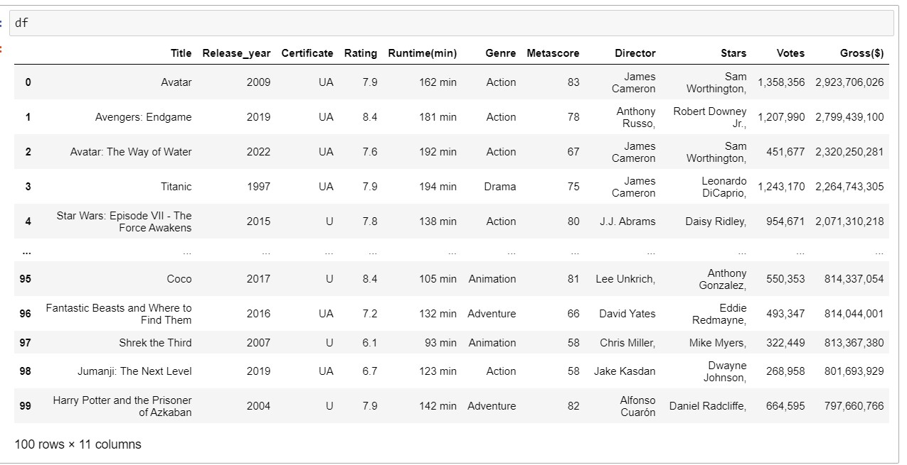
RAW DATA FRAME

Slide 8
DATA CLEANING
Identifying Null values
Identifying Missing values
Treating rows and columns with null values and missing values
Extracting required data from columns to create another columns using regular expressions
Treating columns and converting required columns from object to int or float datatype

Slide 9
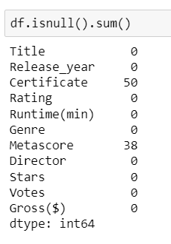
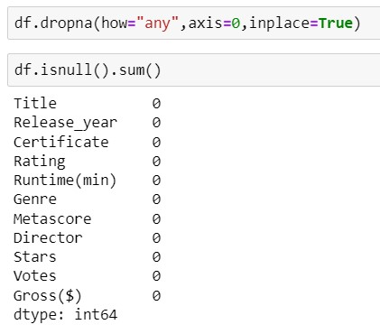




Insights:
From the data we will find the null values are certificate and metascore.
Insights:
After finding the null values we will drop rows from the data where null values are exists.

Slide 10
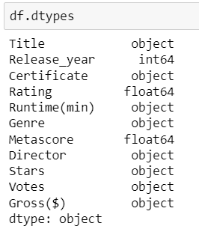
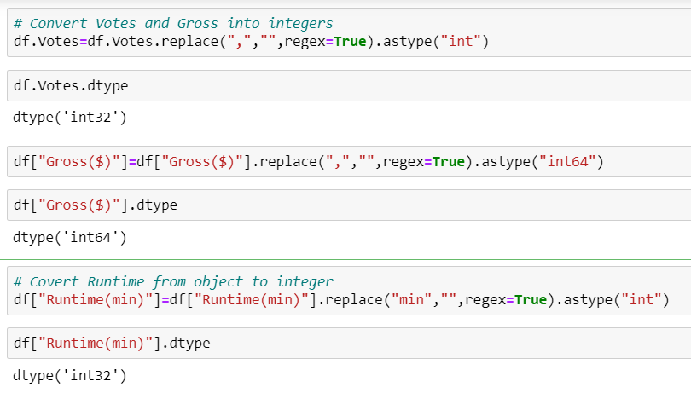



Insights:
From the beside table , Data types of data taken from websites are wrong data types .
Insights:
These code used for change the data type of columns in data collection.

Slide 11
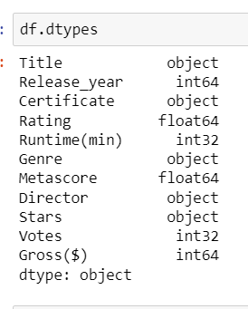
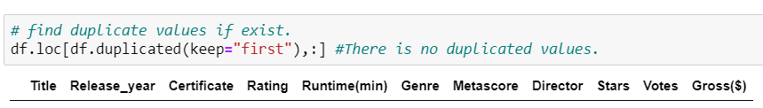



Insights:
After changing the data type of column from the data. Resultant data types of columns is presented in beside figure.
Insights:
after convertion of data types we will find any duplicate values are exists or not.

Slide 12
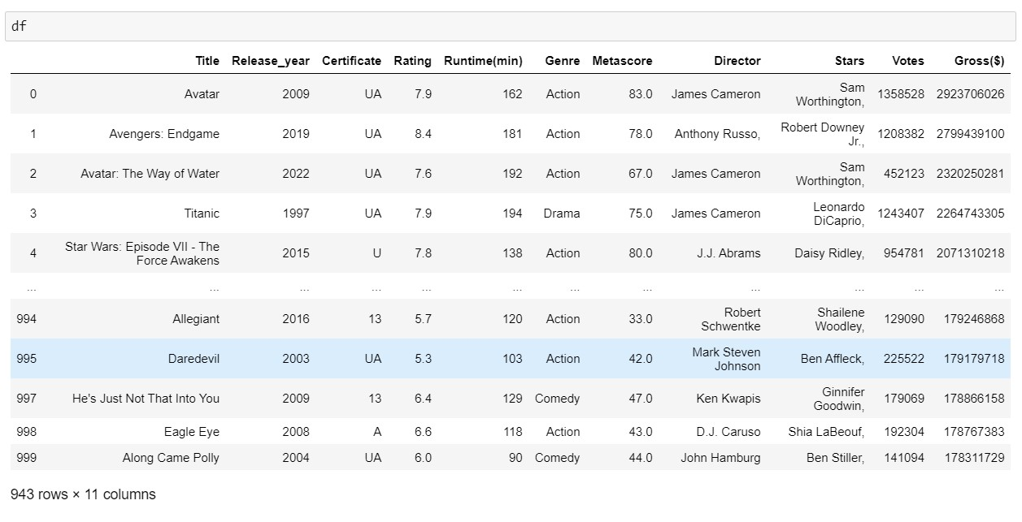
Final Data Frame:

Slide 13
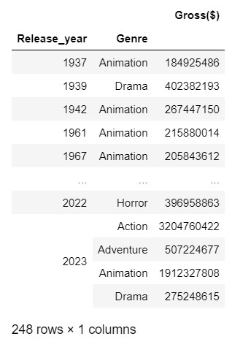
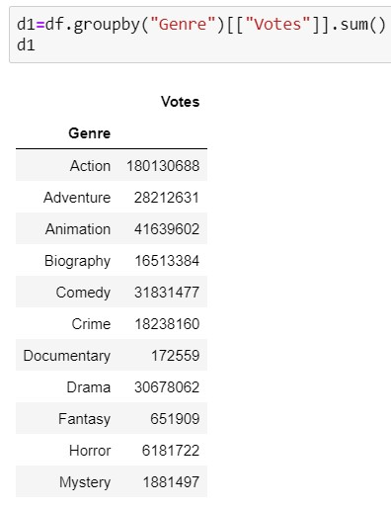
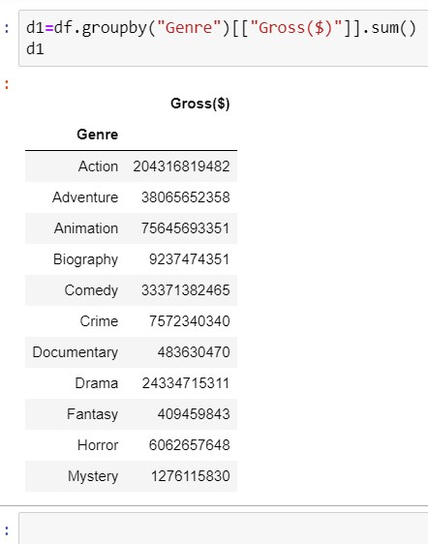
Descriptive Statistics:

Slide 14

DATA VISUALIZATION

Slide 15
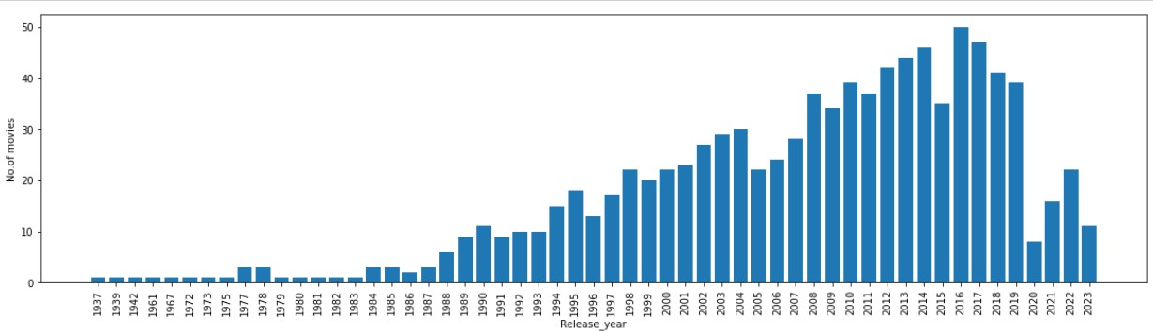
UNIVARIATE ANALYSIS
CATEGORICAL DATA
How are the effects of movies as the years increase?
Insights:
Examine the overall trend in movie releases over the years.we are notice patterns, such as growth of movies were released year by year.

Slide 16
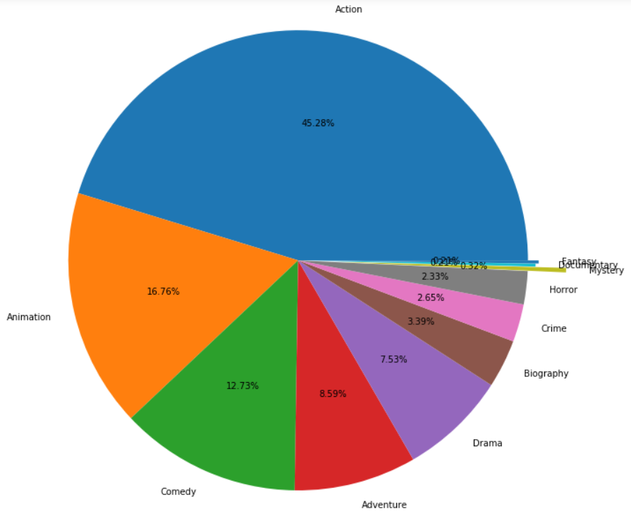
ANALYZE NO.OF MOVIES WERE RELEASED IN GENRE WISE
Insights:
The pie chart visually illustrates the distribution of movies across different genres, revealing which genres dominate the dataset and their respective proportions. This information offers valuable insights into the diversity and popularity of movie genres within the dataset.

Slide 17
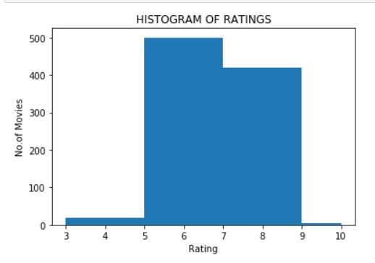
NUMERICAL DATA
DISPLAY RANGE BETWEEN RATING AND MOVIES
Insights:
The histogram reveals that the majority of movies fall within a specific rating range, suggesting a concentration of films with certain ratings, while fewer movies receive extreme or outlier ratings.

Slide 18
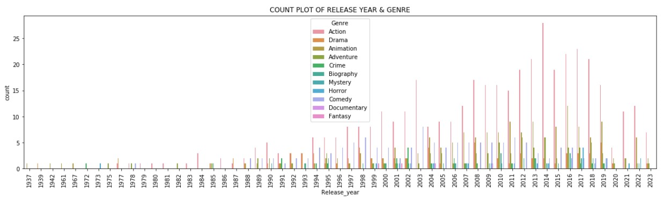
BIVARIATE ANALYSIS
CATEGORICAL DATA Vs CATEGORICAL DATA
Insights:
It will shows that the number of movies released per genre over the years can reveal evolving audience preferences and industry trends, offering a visual narrative of how different genres have gained in popularity throughout cinematic history.

Slide 19
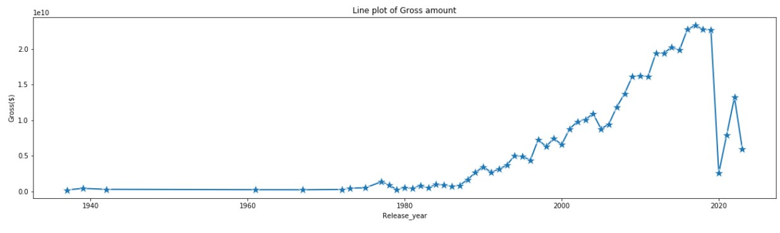
CATEGORICAL DATA Vs NUMERICAL DATA
Insights:
A line plot depicting the relationship between gross revenue and release years reveals how the film industry's earnings have evolved over time, reflecting changing audience preferences and market dynamics.

Slide 20
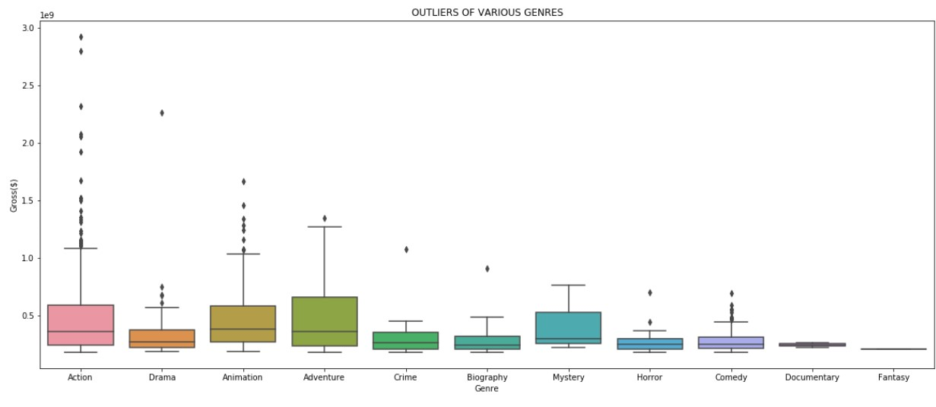
CATEGORICAL DATA Vs NUMERICAL DATA
Insights:
A box plot analysis reveals how movie genres are distributed in terms of gross revenue, providing insights into the range, median, and outliers within each genre category.

Slide 21
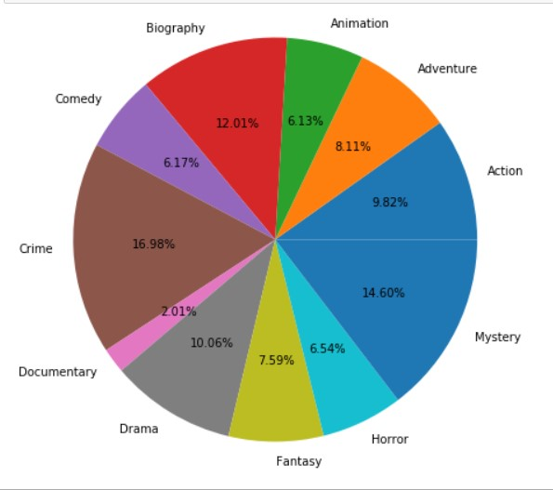
CATEGORICAL DATA Vs NUMERICAL DATA
Insights:
Exploring the relationship between movie genres and votes through a pie plot reveals the distribution of votes across different genres, shedding light on audience preferences.

Slide 22
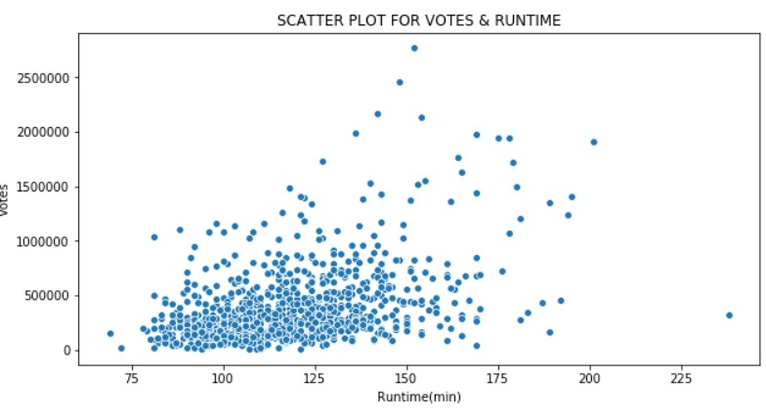
NUMERICAL DATA Vs NUMERICAL DATA
Insights:
In a scatter plot depicting movie runtime against the number of votes, it's evident that shorter runtime movies tend to attract a higher number of votes, possibly due to their accessibility and wider audience appeal.

Slide 23
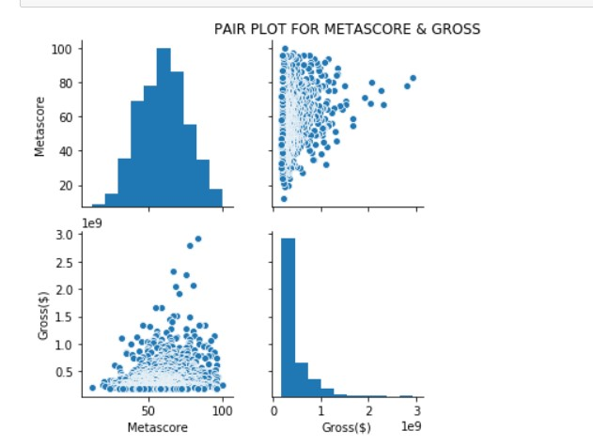
NUMERICAL DATA Vs NUMERICAL DATA
Insights:
A pair plot analysis reveals a correlation between a movie's Metascore rating and its box office gross, suggesting that audience voting preferences can influence a film's financial success.

Slide 24
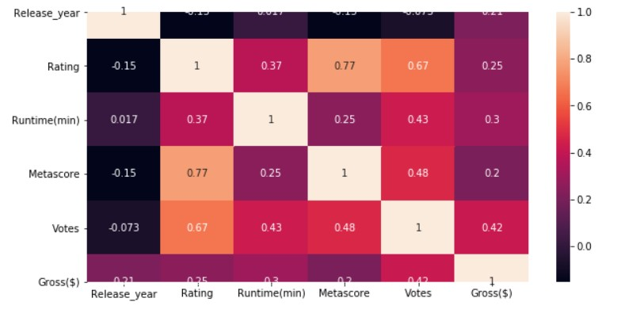
MULTIVARIATE ANALYSIS
Insights:
A heatmap visualization of a movies dataset reveals the correlations and trends between various movie attributes, offering valuable insights into factors influencing a film's success.

Slide 25
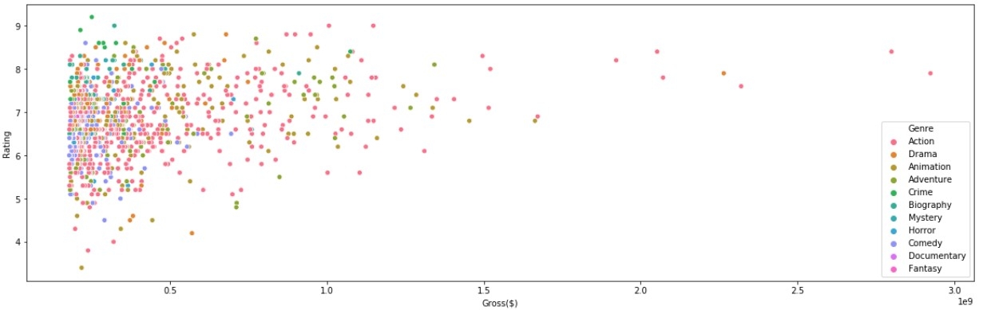
Insights:
A scatter plot comparing movie gross (on the x-axis) to its Rating (on the y-axis) reveals a diverse range of ratings across various genres. Additionally, the size of each data point correlates with the movie's gross revenue, illustrating the financial success of certain genres and their respective ratings.

Slide 26
CHALLENGES FACED:
While I was collecting data from the websites I had to go through each page and do separately.
Every page has Null values and Data missing even through it is presenting web page .
I had gone through each page and checked for any data present but is missing when extracted and added them manually using Python.
If I had to replace more data I just have done any operation on that particular column.

Slide 27
Conclusion:
I here by conclude by sharing my observations in this particular project is:
Here my problem statement was recommending To analyze the gross income from various Genres and also analyze that how Gross will be going in Yearwise.
Considering that to my observations I analyze that the Action Genre is highest viewed by peoples and collect higher collections than other Genres.
By this we conclude that the highest no.of movies were released between 5 to 7 Ratings.
When we compared with Genre and votes we will find that the highest peoples were vote for crime and biography genres.

Slide 28


